Slide 1

UNIVERSITY INSTITUTE OF ENGINEERING
DEPARTMENT- ACADEMIC UNITS
FIRST YEAR ENGINEERING PROGRAMMES
Subject Name : Elementary Data Structures using C++
Subject Code: 23CSH-103
STACK
DISCOVER . LEARN . EMPOWER

Slide 2


Elementary Data Structure Using C++
Course Objectives
To enable the students to understand various stages and constructs of C++ programming language.
To improve their ability to analyze and address variety of problems in C++.
To understand the concept of data structures and various operations on them.
To understand the properties of various data structures and able to identify the strengths and weaknesses of different data structures.
To analyze and compare the efficiency of algorithms and learn to design efficient algorithms for solving computing problems

Slide 3



Course Outcomes
CO Number | Course Outcome
CO1 | Understand the concepts of object-oriented programming including programming process and compilation process.
CO2 | Apply different techniques to decompose a problem and programmed a solution with various concepts of object-oriented programming language.
CO3 | Analyse and explain the behaviour of linear data structure operations using the programming addressed in the course.
CO4 | Implement and evaluate the programs using the syntax and semantics of object-oriented programming.
CO5 | Design the solution of real-world problems in order to determine that the program performs as expected.

Slide 4
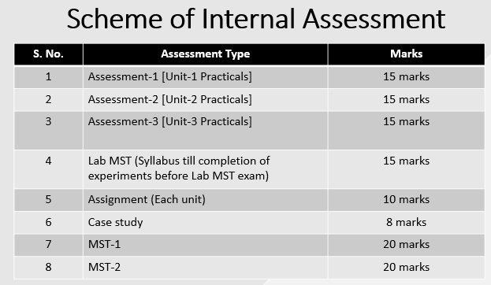
ASSESSMENT PATTERN
The performance of students is evaluated as follows:
 | Theory |  | Practical
Components | Continuous Internal Assessment (CAE) | Semester End Examination (SEE) | Continuous Internal Assessment (CAE) | Semester End Examination (SEE)
Marks | 40 | 60 | 60 | 40
Total Marks | 100 |  | 100

Slide 5
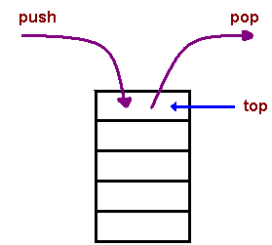
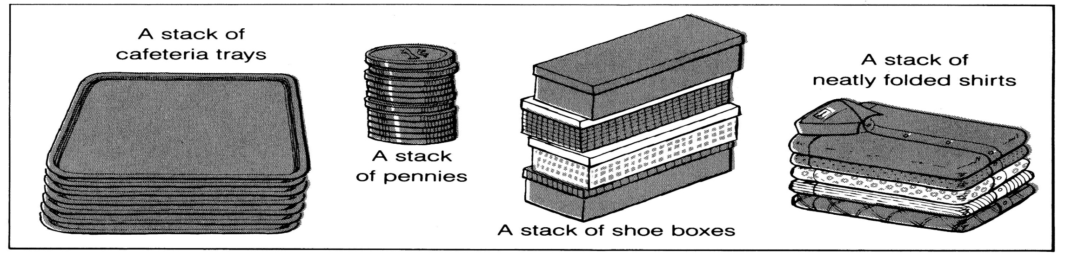
DEFINITION
The last element to be added is the first to be removed (LIFO: Last In, First Out).
A stack is an Abstract Data Type (ADT), commonly used in most programming languages. It is named stack as it behaves like a real-world stack, for example – a deck of cards or stack of trays etc.
It is an ordered group of homogeneous items of elements.
Elements are added to and removed from the top of the stack (the most recently added items are at the top of the stack).

Slide 6
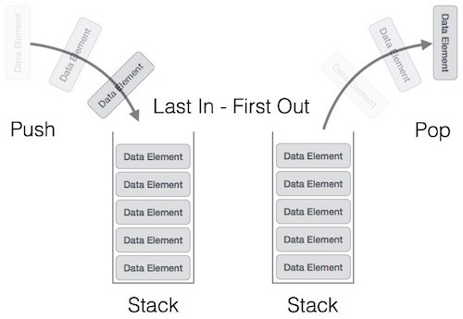
Stack Representation

Slide 7
A stack can be implemented by means of Array, Structure, Pointer, and Linked List. Stack can either be a fixed size one or it may have a sense of dynamic resizing. Here, we are going to implement stack using arrays, which makes it a fixed size stack implementation.
Basic Operations
Stack operations may involve initializing the stack, using it and then de-initializing it. Apart from these basic stuffs, a stack is used for the following two primary operations −
push() − Pushing (storing) an element on the stack.
pop() − Removing (accessing) an element from the stack.
To use a stack efficiently, we need to check the status of stack as well. For the same purpose, the following functionality is added to stacks −
peek() − get the top data element of the stack, without removing it.
isFull() − check if stack is full.
isEmpty() − check if stack is empty.
At all times, we maintain a pointer to the last PUSHed data on the stack. As this pointer always represents the top of the stack, hence named top. The top pointer provides top value of the stack without actually removing it.

Slide 8
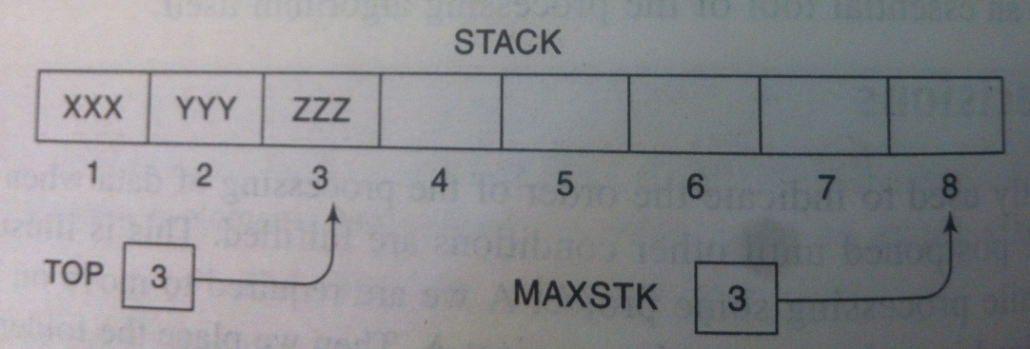
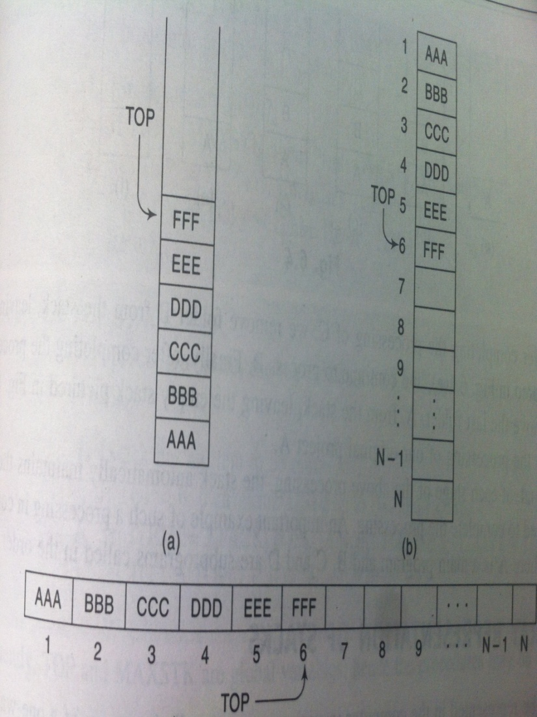
Sequential/ Array representation of Stack
8
Stack may be represented in the computer in various ways, usually by means of a one-way list or a linear array.
In case of linear array, a pointer variable TOP contains the location of the top element of the stack and a variable MAXSTK which gives the maximum number of elements that can be held by the stack.
The condition TOP=0 or TOP=NULL will indicate that the stack is empty.

Slide 9
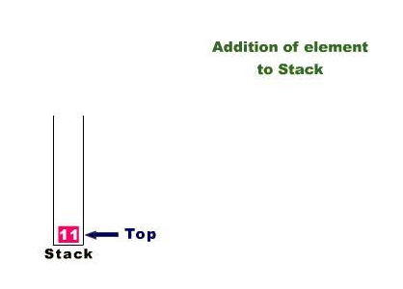
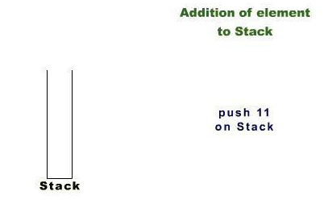
Insertion in a Stack
Stack is implemented here as a one dimensional array of size 7.

Slide 10
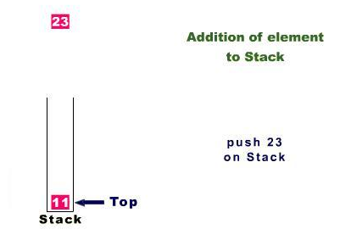
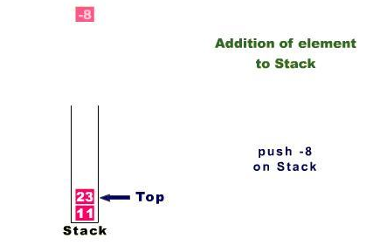
Insertion in a Stack(contd..)

Slide 11
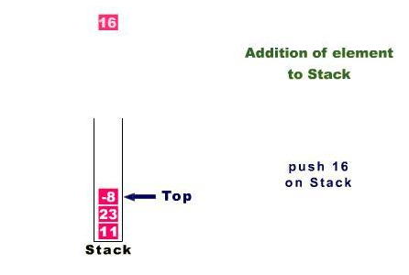
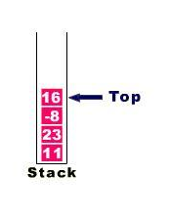
Insertion in a Stack(contd..)

Slide 12
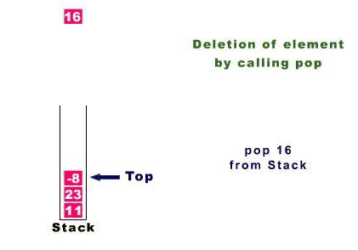
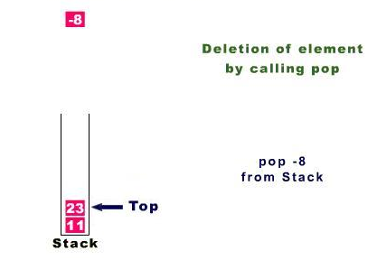
Deletion from stack

Slide 13
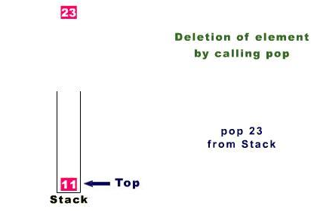
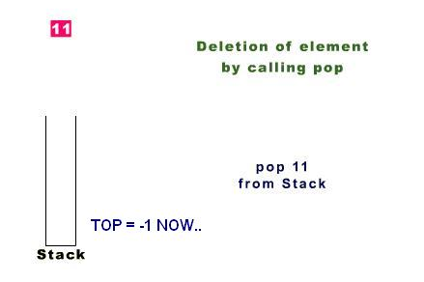
Deletion from stack(contd..)

Slide 14
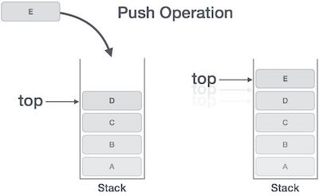
Push Operation
The process of putting a new data element onto stack is known as a Push Operation. Push operation involves a series of steps −
Step 1 − Checks if the stack is full.
Step 2 − If the stack is full, produces an error and exit.
Step 3 − If the stack is not full, increments top to point next empty space.
Step 4 − Adds data element to the stack location, where top is pointing.
Step 5 − Returns success

Slide 15
Algorithm to insert in Stack
Algorithm: PUSH(STACK,TOP,MAXSTK,ITEM)
This procedure pushes an ITEM onto a stack.
1. [Stack already filled?]
If TOP=MAXSTK,
then: Print: OVERFLOW & Exit
2. Set TOP=TOP+1 [Increases TOP by 1]
3. Set STACK[TOP]=ITEM [Inserts ITEM in new TOP position.]
4. Exit

Slide 16
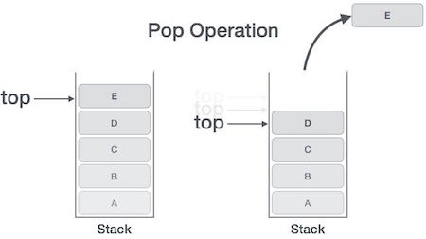
Pop Operation
Accessing the content while removing it from the stack, is known as a Pop Operation. In an array implementation of pop() operation, the data element is not actually removed, instead top is decremented to a lower position in the stack to point to the next value. But in linked-list implementation, pop() actually removes data element and deallocates memory space.
A Pop operation may involve the following steps −
Step 1 − Checks if the stack is empty.
Step 2 − If the stack is empty, produces an error and exit.
Step 3 − If the stack is not empty, accesses the data element at which top is pointing.
Step 4 − Decreases the value of top by 1.
Step 5 − Returns success.

Slide 17
Algorithm to delete in Stack
Algorithm: POP(STACK,TOP,ITEM)
This procedure deletes the top element of STACK & assigns it to the variable ITEM.
1. [Stack has an item to be removed?]
If TOP=0,
then: Print: UNDERFLOW & Exit
2. Set ITEM=STACK[TOP] [Assigns TOP element to ITEM]
3. Set TOP=TOP-1 [Decreases TOP by 1]
4. Exit

Slide 18
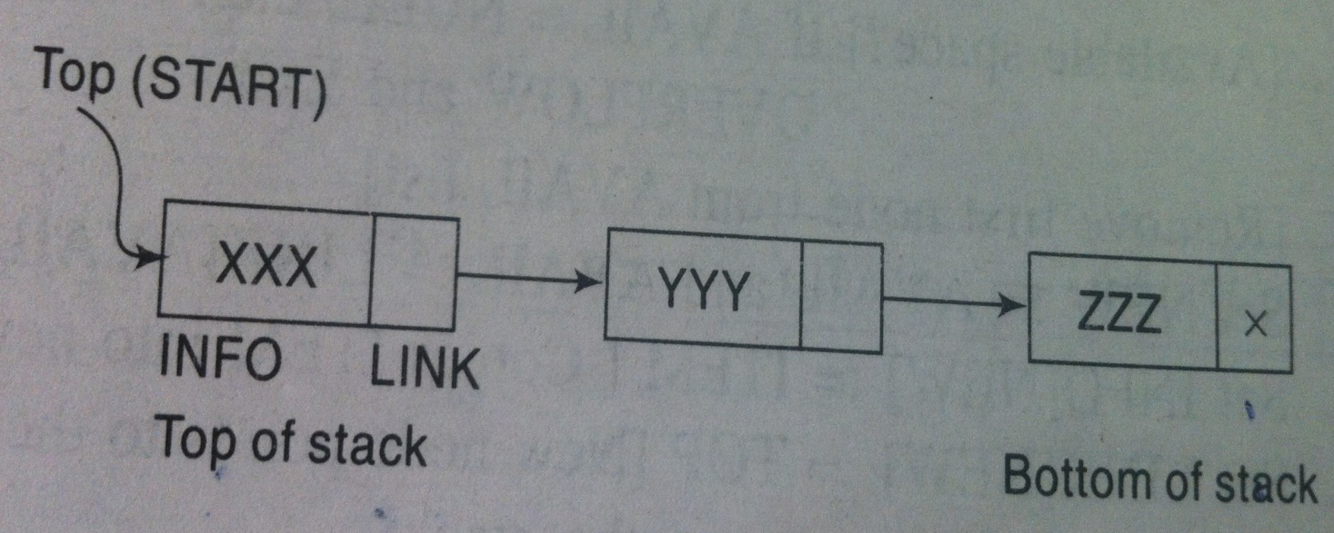
Linked representation of Stack
The INFO fields of the nodes hold the elements of the stack and the LINK fields hold pointers to the neighboring element in the stack.
The START pointer of the linked list behaves as the TOP pointer variable of the stack and the null pointer of the last node in the list signals the bottom of stack.

Slide 19
Notations
An arithmetic expression can be written in three different but equivalent notations, i.e., without changing the essence or output of an expression. These notations are −
Infix Notation
Prefix (Polish) Notation
Postfix (Reverse-Polish) Notation
These notations are named as how they use operator in expression. We shall learn the same here in this chapter.
Infix Notation
We write expression in infix notation, e.g. a - b + c, where operators are used in-between operands. It is easy for us humans to read, write, and speak in infix notation but the same does not go well with computing devices. An algorithm to process infix notation could be difficult and costly in terms of time and space consumption.
Prefix Notation
In this notation, operator is prefixed to operands, i.e. operator is written ahead of operands. For example, +ab. This is equivalent to its infix notation a + b. Prefix notation is also known as Polish Notation.

Slide 20
Postfix Notation
This notation style is known as Reversed Polish Notation. In this notation style, the operator is postfixed to the operands i.e., the operator is written after the operands. For example, ab+. This is equivalent to its infix notation a + b.
The following table briefly tries to show the difference in all three notations −
Sr.No. | Infix Notation | Prefix Notation | Postfix Notation
1 | a + b | + a b | a b +
2 | (a + b) ∗ c | ∗ + a b c | a b + c ∗
3 | a ∗ (b + c) | ∗ a + b c | a b c + ∗
4 | a / b + c / d | + / a b / c d | a b / c d / +
5 | (a + b) ∗ (c + d) | ∗ + a b + c d | a b + c d + ∗
6 | ((a + b) ∗ c) - d | - ∗ + a b c d | a b + c ∗ d -

Slide 21
Precedence
When an operand is in between two different operators, which operator will take the operand first, is decided by the precedence of an operator over others.
Associativity
Associativity describes the rule where operators with the same precedence appear in an expression. For example, in expression a + b − c, both + and – have the same precedence, then which part of the expression will be evaluated first, is determined by associativity of those operators. Here, both + and − are left associative, so the expression will be evaluated as (a + b) − c.
Precedence and associativity determines the order of evaluation of an expression. Following is an operator precedence and associativity table (highest to lowest) −
In a + b*c, the expression part b*c will be evaluated first, with multiplication as precedence over addition. We here use parenthesis for a + b to be evaluated first, like (a + b)*c.
Sr.No. | Operator | Precedence | Associativity
1 | Exponentiation ^ | Highest | Right Associative
2 | Multiplication ( ∗ ) & Division ( / ) | Second Highest | Left Associative
3 | Addition ( + ) & Subtraction ( − ) | Lowest | Left Associative

Slide 22
INFIX, POSTFIX & PREFIX
Conversion from INFIX to POSTFIX- The only rules to remember during the conversion process are that operators with highest precedence are converted first and that after a portion of the expression has been converted to postfix it is to be treated as a single operand.
When un-parenthesized operators of the same precedence are scanned, the order is assumed to be left to right except in the case of exponentiation, where the order is assumed to be from right to left.
Thus, A+B+C means (A+B)+C whereas, A^B^C means A^(B^C)
PRECEDENCE – HIGHEST to LOWEST
BRACKETS
EXPONENTIATION (↑^$)
MULTIPLICATION/DIVISION
ADDITION/SUBTRACTION

Slide 23
INFIX to POSTFIX Examples
INFIX | POSTFIX
A+B | AB+
A+B-C | AB+C-
(A+B) * (C-D) | AB+CD-*
A$B*C-D+E/F/(G+H) | AB$C*D-EF/GH+/+
((A+B)*C-(D-E))$(F+G) | AB+C*DE- -FG+$
A-B/(C*D$E) | ABCDE$*/-
A+((B+C)*(D+E))+F/G | ABC+DE+*+FG/+
A+(B+C*D+E)+F/G | ABCD*+E++FG/+
A-B/(C^D)+(E*F) | ABCD^/-EF*+
A*(B+C)+(B/D)*A+Z*U | ABC+*BD/A*+ZU*+
A+(B*C-(D/E^F)*G)*H | ABC*DEF^/G*-H*+

Slide 24
Algorithm for Infix to Postfix
Suppose Q is an arithmetic expression written in infix notation. This algorithm also finds the equivalent postfix expression P.
Push “(“ onto stack and add “)” to the end of Q.
Scan Q from left to right and repeat steps 3 to 6 for each element of Q until the stack is empty:
3) If an operand is encountered, add it to P.
4) If a left parenthesis is encountered, push it onto stack.
5) If an operator ⊗ is encountered, then:
(a) Repeatedly pop from stack and add to P each operator(on top of stack) which has the same precedence as or higher precedence than ⊗.
(b) Add ⊗ to stack.
[End of if structure]
If a right parenthesis is encountered, then:
(a) Repeatedly pop from stack and add to P each operator until a left parenthesis is encountered.
(b) Remove a left parenthesis.
[end of if structure]

Slide 25
Application of stacks :conversion from infix to postfix representation
Symbol scanned | Stack | Expression P
2 | ( | 2
* | (* | 2
3 | (* | 23
Suppose we want to convert 2*3/(2-1)+5*3 into Postfix form,
Push “(“ onto stack and add “)” to the end of expression.
/ | (/ | 23*
( | (/( | 23*
2 | (/( | 23*2
- | (/(- | 23*2
1 | (/(- | 23*21
) | (/ | 23*21-
+ | (+ | 23*21-/
5 | (+ | 23*21-/5
* | (+* | 23*21-/53
3 | (+* | 23*21-/53
) | Empty | 23*21-/53*+

Slide 26
Application of stacks :conversion from infix to postfix representation
Symbol scanned | Stack | Expression P
( | ((
A | (( | A
+ | ((+ | A
B | ((+ | AB
) | ( | AB+
* | (* | AB+
( | (*( | AB+
C | (*( | AB+C
- | (*(- | AB+C
D | (*(- | AB+CD
) | (* | AB+CD-
) |  | AB+CD-*
Suppose we want to convert (A+B)*(C-D) into Postfix form,
Push “(“ onto stack and add “)” to the end of expression.

Slide 27
Application of stacks :conversion from infix to postfix representation
Symbol scanned | Stack | Expression P
( | ((
A | (( | A
+ | ((+ | A
B | ((+ | AB
) | ( | AB+
* | (* | AB+
C | (* | AB+C
- | (- | AB+C*
( | (-( | AB+C*
D | (-( | AB+C*D
- | (-(- | AB+C*D
E | (-(- | AB+C*DE
) | (- | AB+C*DE-
^ | (-^ | AB+C*DE-
F | (-^ | AB+C*DE-F
) |  | AB+C*DE-F^-
Suppose we want to convert (A+B)*C – (D-E)^F into Postfix form,
Push “(“ onto stack and add “)” to the end of expression.

Slide 28
Application of stacks :conversion from infix to postfix representation
Symbol scanned | Stack | Expression P
A | ( | A
+ | (+ | A
( | (+( | A
B | (+( | AB
* | (+(* | AB
C | (+(* | ABC
- | (+(- | ABC*
( | (+(- | ABC*
D | (+(- | ABC*D
/ | (+(-(/ | ABC*D
E | (+(-(/ | ABC*DE
^ | (+(-(/^ | ABC*DE
F | (+(-(/^ | ABC*DEF
) | (+(- | ABC*DEF^/
* | (+(-* | ABC*DEF^/
G | (+(-* | ABC*DEF^/G
) | (+ | ABC*DEF^/G*-
* | (+* | ABC*DEF^/G*-
H | (+* | ABC*DEF^/G*-H
) |  | ABC*DEF^/G*-H*+
Suppose we want to convert A+(B*C-(D/E^F)*G)*H into Postfix form,

Slide 29
Application of stacks :conversion from infix to postfix representation
Symbol scanned | Stack | Expression P
A | ( | A
^ | (^ | A
B | (^ | AB
* | (* | AB^
C | (* | AB^C
- | (- | AB^C*
D | (- | AB^C*D
+ | (+ | AB^C*D-
E | (+ | AB^C*D-E
/ | (+/ | AB^C*D-E
F | (+/ | AB^C*D-EF
/ | (+/ | AB^C*D-EF/
( | (+/( | AB^C*D-EF/
G | (+/( | AB^C*D-EF/G
+ | (+/(+ | AB^C*D-EF/G
H | (+/(+ | AB^C*D-EF/GH
) | (+/ | AB^C*D-EF/GH+
) |  | AB^C*D-EF/GH+/+
Suppose we want to convert A^B*C-D+E/F/(G+H)
into Postfix form,

Slide 30
Application of stacks :conversion from infix to postfix representation
Symbol scanned | Stack | Expression P
A | ( | A
* | (* | A
B | (* | AB
- | (- | AB*
C | (- | AB*C
- | (- | AB*C-
D | (- | AB*C-D
+ | (+ | AB*C-D-
E | (+ | AB*C-D-E
* | (+* | AB*C-D-E
F | (+* | AB*C-D-EF
- | (- | AB*C-D-EF*+
G | (- | AB*C-D-EF*+G
/ | (-/ | AB*C-D-EF*+G
H | (-/ | AB*C-D-EF*+GH
* | (-* | AB*C-D-EF*+GH/
T | (-* | AB*C-D-EF*+GH/T
) |  | AB*C-D-EF*+GH/T*-
Suppose we want to convert A*B-C-D+E*F-G/H*T
into Postfix form,

Slide 31
Postfix Evaluation Algorithm
Step 1 − scan the expression from left to right
Step 2 − if it is an operand push it to stack
Step 3 − if it is an operator pull operand from stack and perform operation
Step 4 − store the output of step 3, back to stack
Step 5 − scan the expression until all operands are consumed
Step 6 − pop the stack and perform operation

Slide 32
Application of stacks: Evaluating a postfix expression
This algorithm finds the value of an arithmetic expression P written in postfix notation.
Add a right parenthesis “)” at the end of P(expression).
Scan P from left to right and repeat steps 3 & 4 for each element of P until the sentinel “)” is encountered.
If an operand is encountered, put it on STACK.
If an operator ⊗ is encountered , then:
a) Remove the two top elements of stack, where A is the top element and B is the next-to-top element.
b) Evaluate B ⊗ A.
c) Place the result of (b) back on stack.
[End of if structure]
[End of step2 loop]
5) Set value equal to the top element on stack.
6) Exit

Slide 33
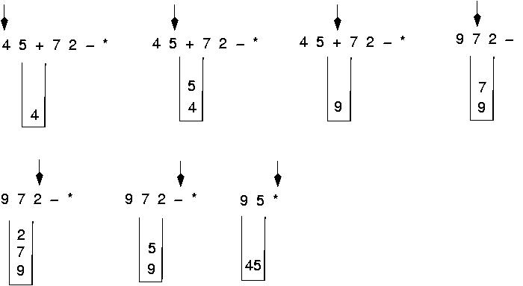
Evaluating a postfix expression(contd..)
Final result is: 45

Slide 34
Evaluate these postfix expressions
6 2 3 + - 3 8 2 / + * 2 ^ 3 +
5 6 2 + * 12 4 / -
2 3 1 * + 9 –
2 10 + 9 6 - /
1 2 3 * + 4 -
Ans 1: 52
Ans 2: 37
Ans 3: -4
Ans 4: 4
Ans 5: 3

Slide 35
INFIX to PREFIX Examples
INFIX | POSTFIX
A+B | +AB
A+B-C | -+ABC
(A+B) * (C-D) | *+AB-CD
A$B*C-D+E/F/(G+H) | +-*$ABCD//EF+GH
((A+B)*C-(D-E))$(F+G) | $-*+ABC-DE+FG
A-B/(C*D$E) | -A/B*C$DE
A+((B+C)*(D+E))+F/G | ++A*+BC+DE/FG
A+(B+C*D+E)+F/G | ++A++B*CDE/FG
A-B/(C^D)+(E*F) | +-A/B^CD*EF
A*(B+C)+(B/D)*A+Z*U | ++*A+BC*/BDA*ZU
A+(B*C-(D/E^F)*G)*H | +A*-*BC*/D^EFGH

Slide 36
Prefix to Infix
operator
Left operand
Right operand
PREFIX : +A-BC
+A-BC
+A(B-C)
INFIX: (A+(B-C))

Slide 37
Postfix to Infix
- So pop
POSTFIX: ABCDE-+/*EF*-
E
D
C
B
A
(D-E)
C
B
A
E
D
C
B
A
D
C
B
A
B
A
C
B
A
A
+ So pop
/ So pop
* So pop
(D-E)
C
B
A
(C+(D-E))
B
A
(C+(D-E))
B
A
(B/(C+(D-E))
A
(B/(C+(D-E))
A

Slide 38
Postfix to Infix(contd..)
* So pop
(A*(B/(C+(D-E))))
E
(A*(B/(C+(D-E))))
F
E
(A*(B/(C+(D-E))))
F
E
(A*(B/(C+(D-E))))
- So pop
(E*F)
(A*(B/(C+(D-E))))
(E*F)
(A*(B/(C+(D-E))))
(E*F)-(A*(B/(C+(D-E))))

Slide 39
Applications of Stack
Express Evolution
Express interchange
Infix changes to Postfix
Infix changes to Prefix
Postfix changes to Infix
Prefix changes to Infix
Parsing easily done
Simulation of recursion
Function call

Slide 40
REFERENCES
https://www.cs.cmu.edu/~adamchik/15-121/lectures/Stacks%20and%20Queues/Stacks%20and%20Queues.html
Data Structures with C/ schaum outline series/ volume 2
https://www.geeksforgeeks.org/stack-data-structure-introduction-program/
https://www.geeksforgeeks.org/queue-set-1introduction-and-array-implementation/
http://www.yashcode.com/2017/11/prefix-to-postfix-conversion-using-stack.html
Lipschutz, Seymour, “Data Structures”, Schaum's Outline Series, Tata McGraw Hill.
Gilberg/Forouzan,” Data Structure with C ,Cengage Learning.
Augenstein,Moshe J , Tanenbaum, Aaron M, “Data Structures using C and C++”, Prentice Hall of India.
Goodrich, Michael T., Tamassia, Roberto, and Mount, David M., “Data Structures and Algorithms in C++”, Wiley Student Edition.
Aho, Alfred V., Ullman, Jeffrey D., Hopcroft ,John E. “Data Structures and Algorithms”, Addison Wesley

Slide 41
THANK YOU

